Slide 1
2021-1 IMP AR PROJECT
AR INDIAN POKER
TEAM 5
Song Jihye, Jang Yoona, Kim Yejin, Kim Gyeongjin

Slide 2
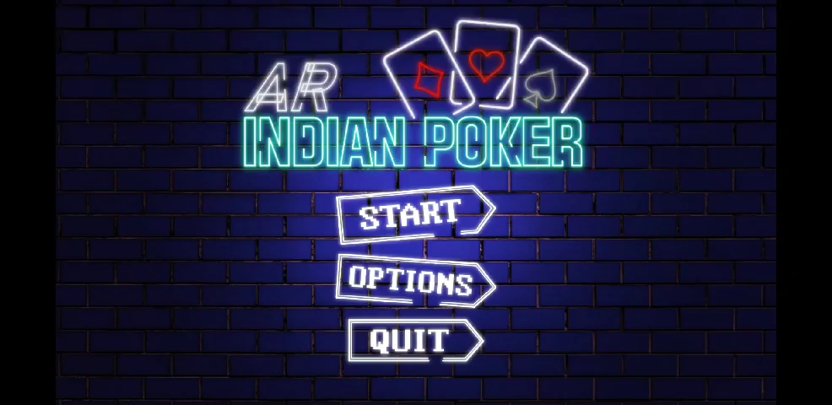
Play Video

Slide 3


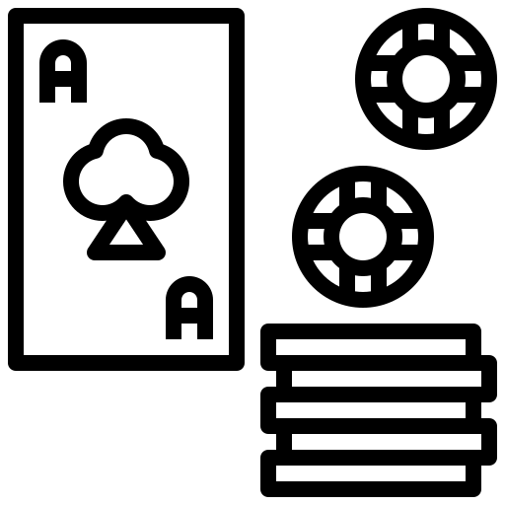

Project Introduction
Motivations
+
▶
Normal card / board games
cannot be played
without supplies
AR has good advantages
of showing
non-existent objects virtually
Use AR to enjoy the game
without any supplies
Especially, Indian Poker Game

Slide 4
Project Introduction
Details
Individual competition Indian Poker Game with AR system
Classification
AR Game application
Unity Version
2020.2.7f1
Platform
AR Foundation, AR Core
Target Device
Android
Tracking
Marker-based & Markerless

Slide 5

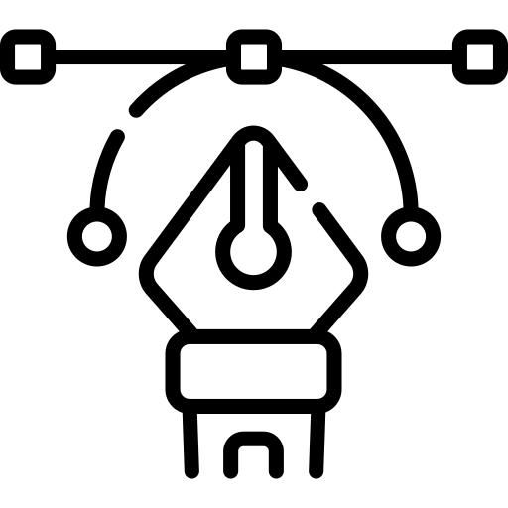


Work Division
Song Jihye
-
UI
Jang Yoona
-
AR Feature
Kim Yejin
-
GamePlay
Kim Gyeongjin
-
Gameplay

Slide 6
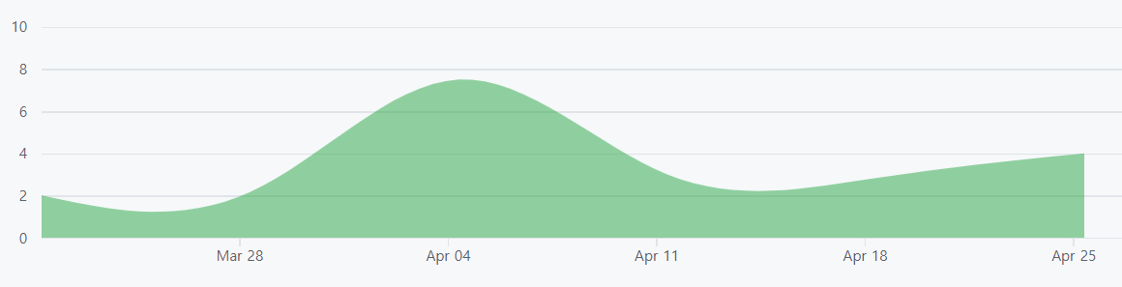
Project progress
Plan
-3/19 | | Idea pitch, first plan
3/20 - 3/26 | | Scenario
3/27 - 4/2 | | basic features (image tracking, basic UI)
4/3 - 4/9 | | First prototype
4/10 - 4/16 | | Discussion on Gameplay
4/17 - 4/23 | | Detailed implementation of UI
4/24 - 4/29 | | Detailed implementation of gameplay
4/30 | | Final presentation
5/1 - 5/5 | | Complement, Trailer Video

Slide 7




Project progress
Tool

Slide 8
Major Features
Main scene | menu list
GamePlay | situation ment, button
Betting chips
Spin ordering arrow
System’s card appears
AR
setting
GUI
Scene
Selection
Image
Tracking
Plane
Tracking
3D content
interacting
AR project setup
Main Scene
GamePlay(Select card)
GamePlay2(Competition)
Making game board

Slide 9


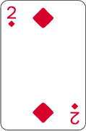
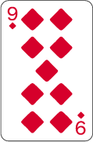
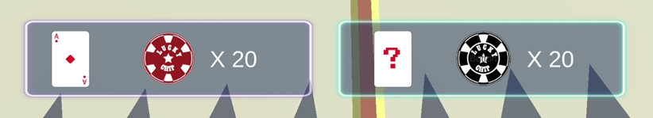
How to play
A card with bigger number on it becomes the winner.
Try to get counterpart’s chips as much as you can by thinking
based on the other’s card number

Slide 10


System Architecture
▶
▶
MAIN
GAMEPLAY1
GAMEPLAY2
Start | change scene to
gameplay1
Option | setting ( sound..etc)
Quit | exit app
Game intro ment
Touch arrow to betting order
Use image tracking to check
com’s card
Change scene to gameplay2
Plane detection to make
game board
Betting chips
Decide game result

Slide 11

Description Component
Main Scene
Start button
- Using SceneManager Loadscene to change
Gameplay scene
Option button
- setting options are enable
Quit button
- Application Quit

Slide 12
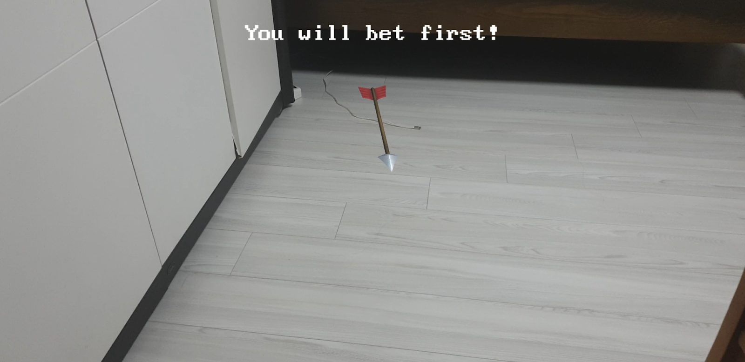
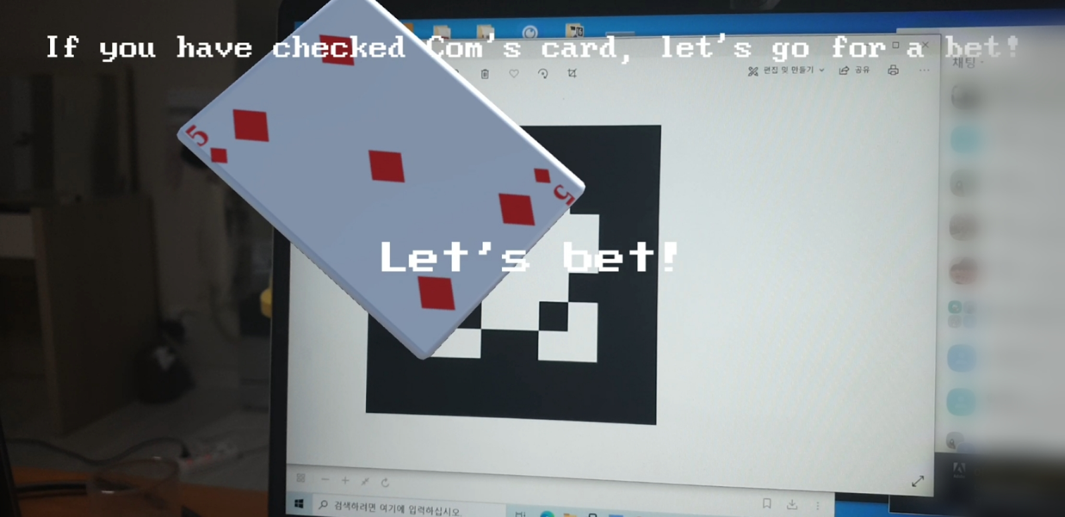
Description Component
GamePlay1
01 Decide the turn
Touch the rotating arrow and it stops rotating.
The person(or computer) in the direction of arrow
is pointing to goes first.
*Employed technique : 3D object interaction
02 Check the counterpart(computer)’s card
Once the marker is detected, a random card appears
on the marker
*A card is limited to diamond ace-10, total 10 cards
*Employed technique : marker-based image tracking

Slide 13
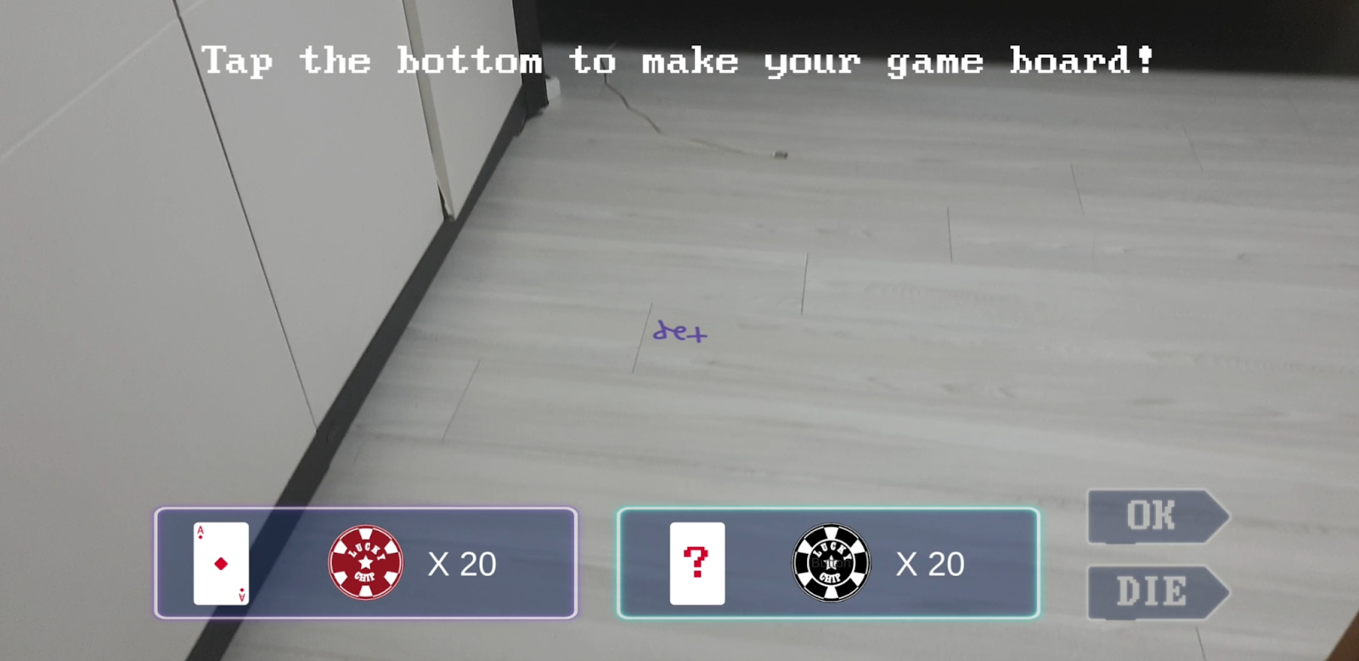
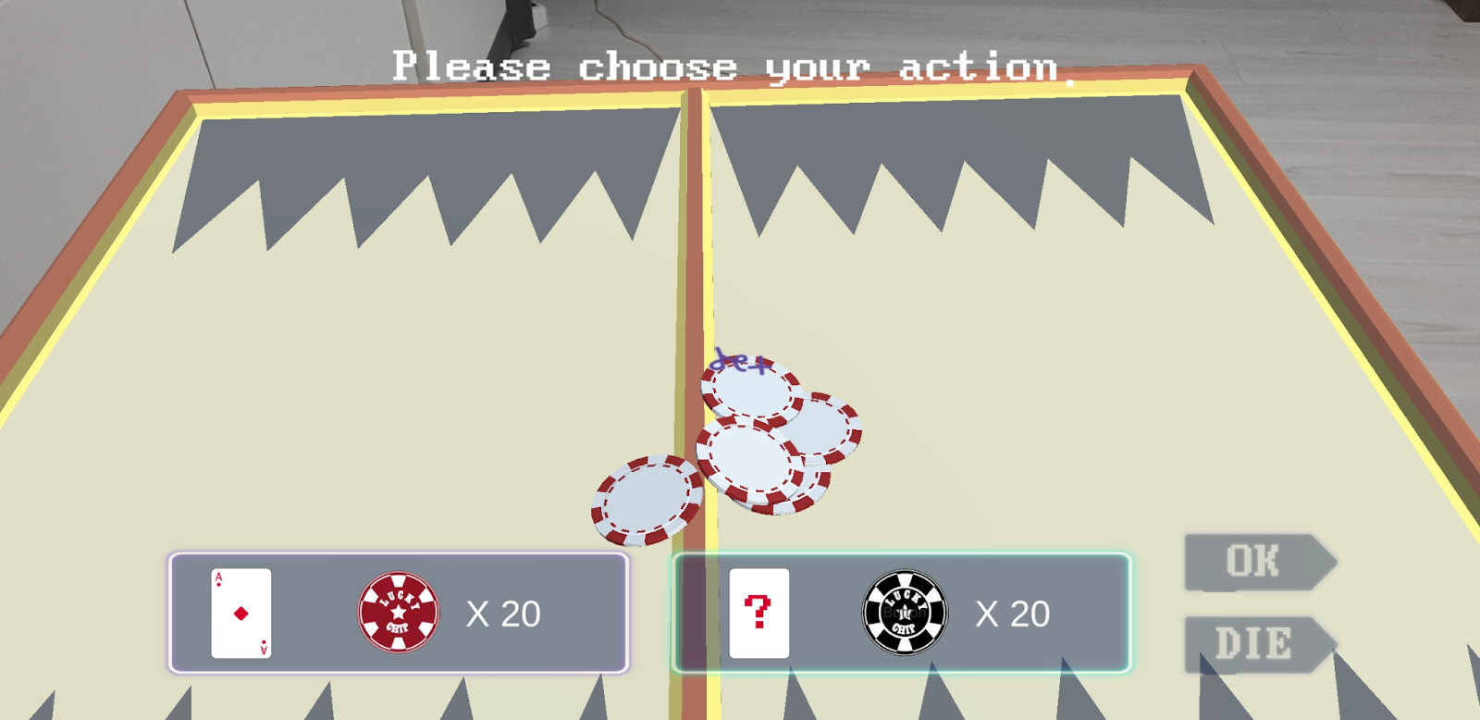
Description Component
GamePlay2
01 Set the gameboard
Indicator ‘tap’ appears on the plane after the plane is detected
If the indicator is touched, the gameboard is set
*Employed technique : plane tracking
02 Computer’s turn
Edit the win formula and make the computer system bet on it.

Slide 14
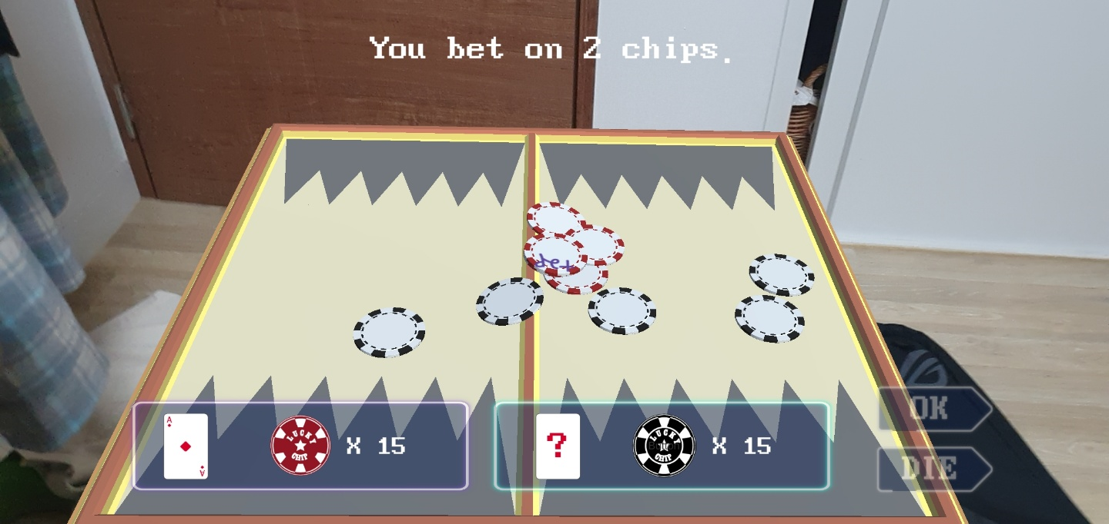
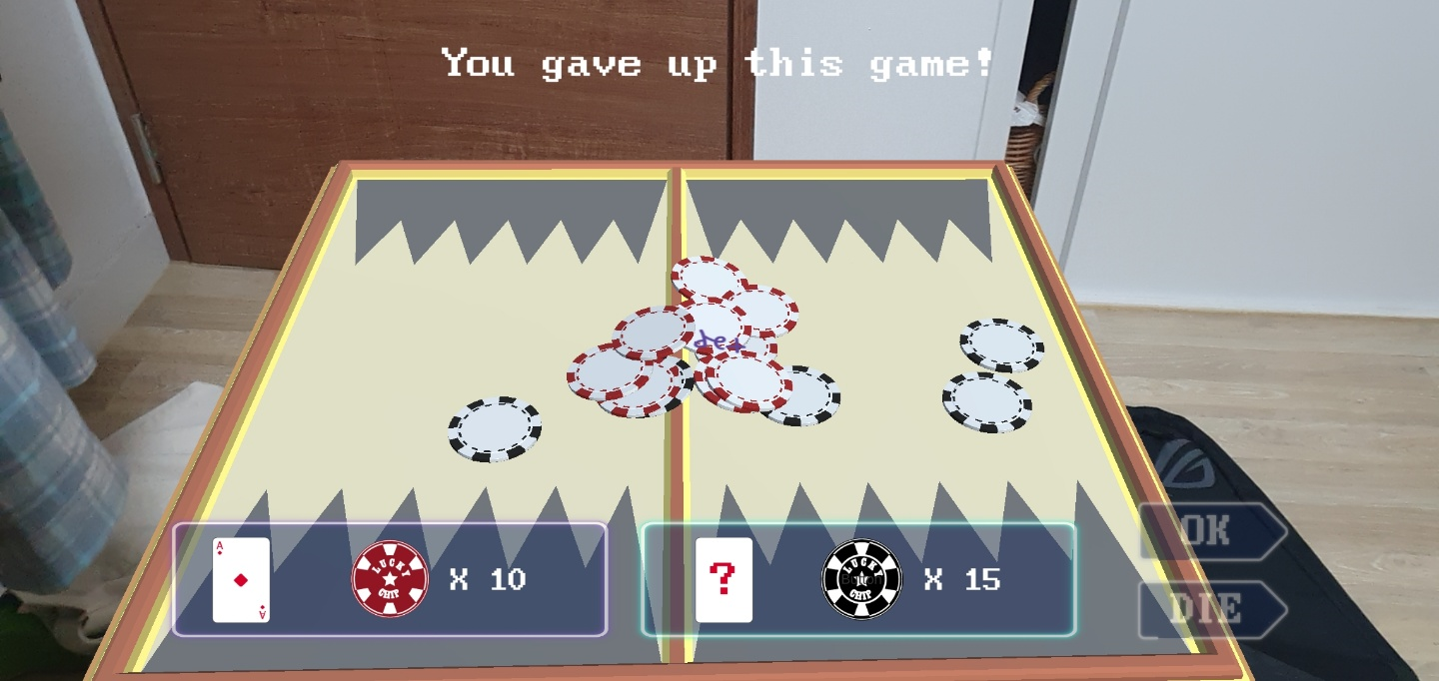
Description Component
GamePlay2
03 Player’s turn
Select the button ‘ok’ for betting, ‘die’ for giving up.
- Ok : Player can bet the chip on the game board by
tapping it.
Should bet more than the counterpart’s chips
and less than 20 chips.
- Die : the counterpart wins

Slide 15
Remaining Implementations
01 Edit the win formula and make the computer system bet on it.
02 Decide game result and show match result
03 Add more audio sources

Slide 16


References
| 3D OBJECTS |
| SOUNDS |
free little games asset pack (unity asset store)
Cartoon weapon pack (unity asset store)
Board games (unity asset store)
Three Wise People
(No Copyright Audio Library)
Chip Falling Sound
(No Copyright Audio Library)

Slide 17
Thank you

